Slide 1
Soal Praktikum Week 14 Languages and Grammars Matdis Diploma
YAG

Slide 2
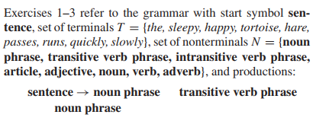
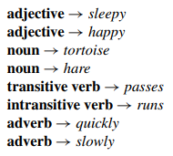
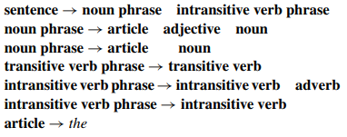

Slide 3

Soal No. 1

Slide 4

Soal No. 2

Slide 5

Soal No 3

Slide 6
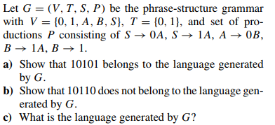
Soal No. 4

Slide 7

Soal No. 5

Slide 8
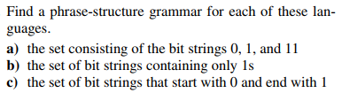
Soal No. 6
J
k

Slide 9

Soal No. 7

